Slide 1
Using Machine Learning and Interactive Graphics to Find New Cancer Targets
David Cooper, Research Statistics
Benjamin Schwartz, Synthetic Lethals
GlaxoSmithKline. Collegeville, PA
20 August 2019

Slide 2
Thank you to my collaborators
Boris Wilson, Melissa Stern, Ravi Nagajaran
Benjamin Schwartz, Euan Stronach
Junping Jing, Hui Zhou, Dan Felitsky
Broad Institute and Sanger Institute – CRISPR knockout data
Discovery team – validation by knockout, knock-in
Development team – screening for tool compounds

Slide 3


Slide 4
Nothing is less real than realism.
Details are confusing.
It is only by selection, by elimination,
by emphasis, that we get at the
real meaning of things.
Georgia O’Keeffe

Slide 5
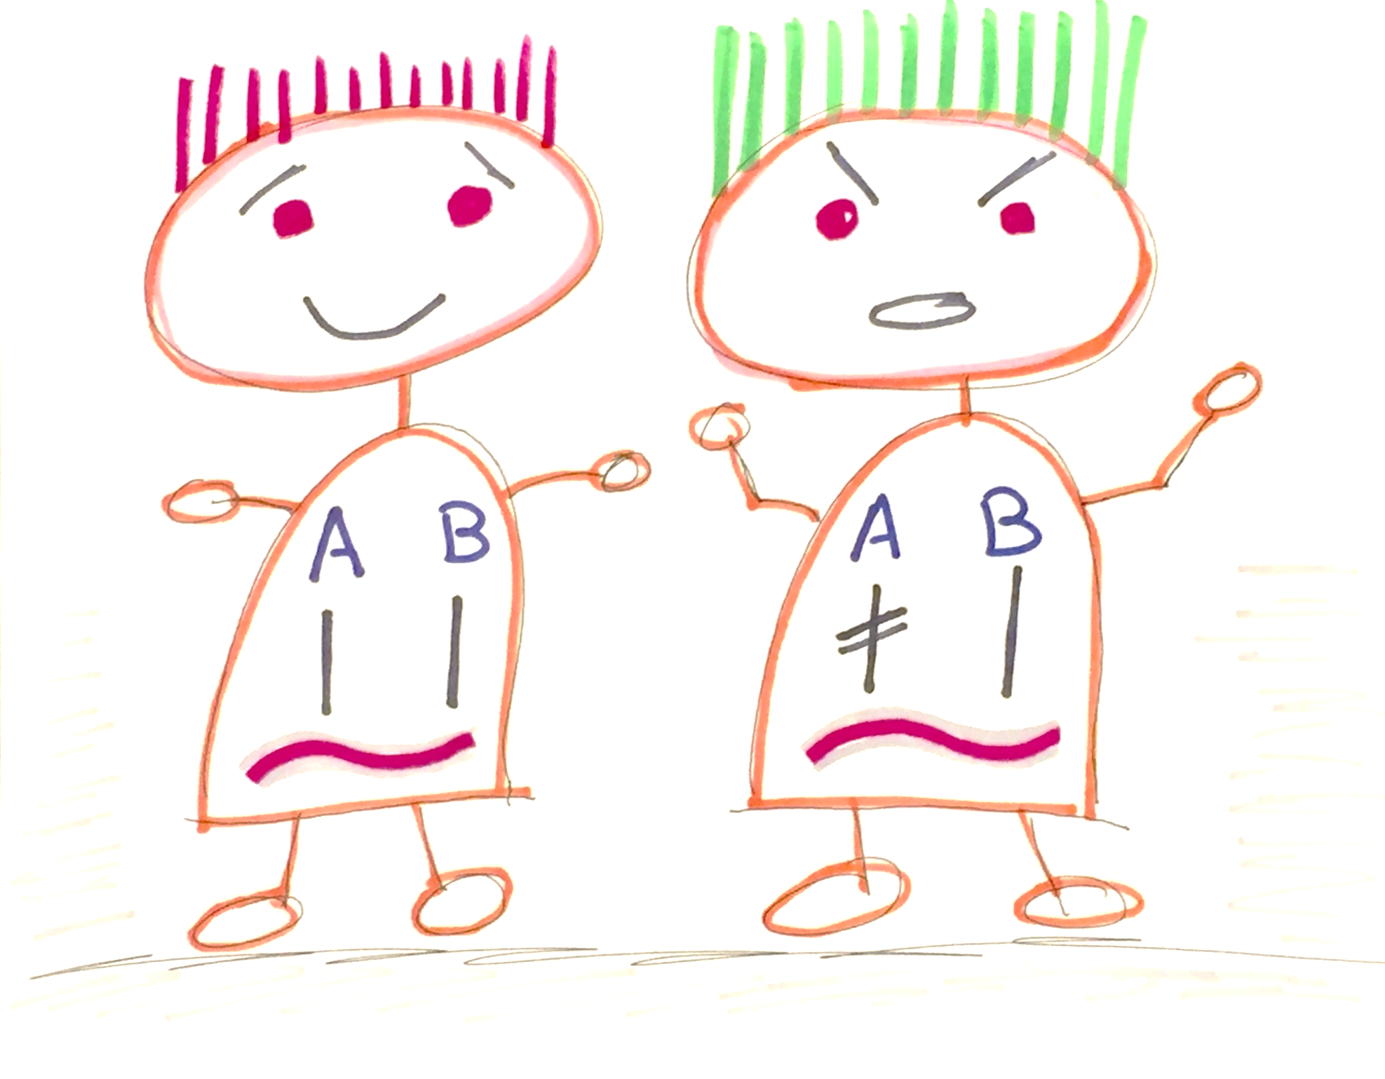

Slide 6
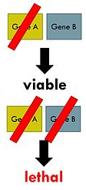
A-B is a Synthetic Lethal Pair
somatic
mutation
CRISPR knockout
Drug therapies

Slide 7
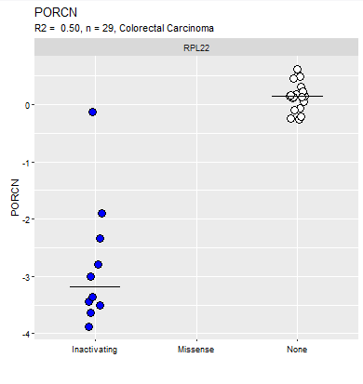

Slide 8
My subjects are cell lines
Y (vector) is a knockout phenotype – growth under knockout, for one gene X (wide) is mutation data for many genes
Is Y predictable? If so, which X’s are important?
Random Forest modeling the model prediction is an average of many weak predictors (trees)
Francis Galton 1906 (crowdsourcing)
Y = dressed weight of an ox

Slide 9
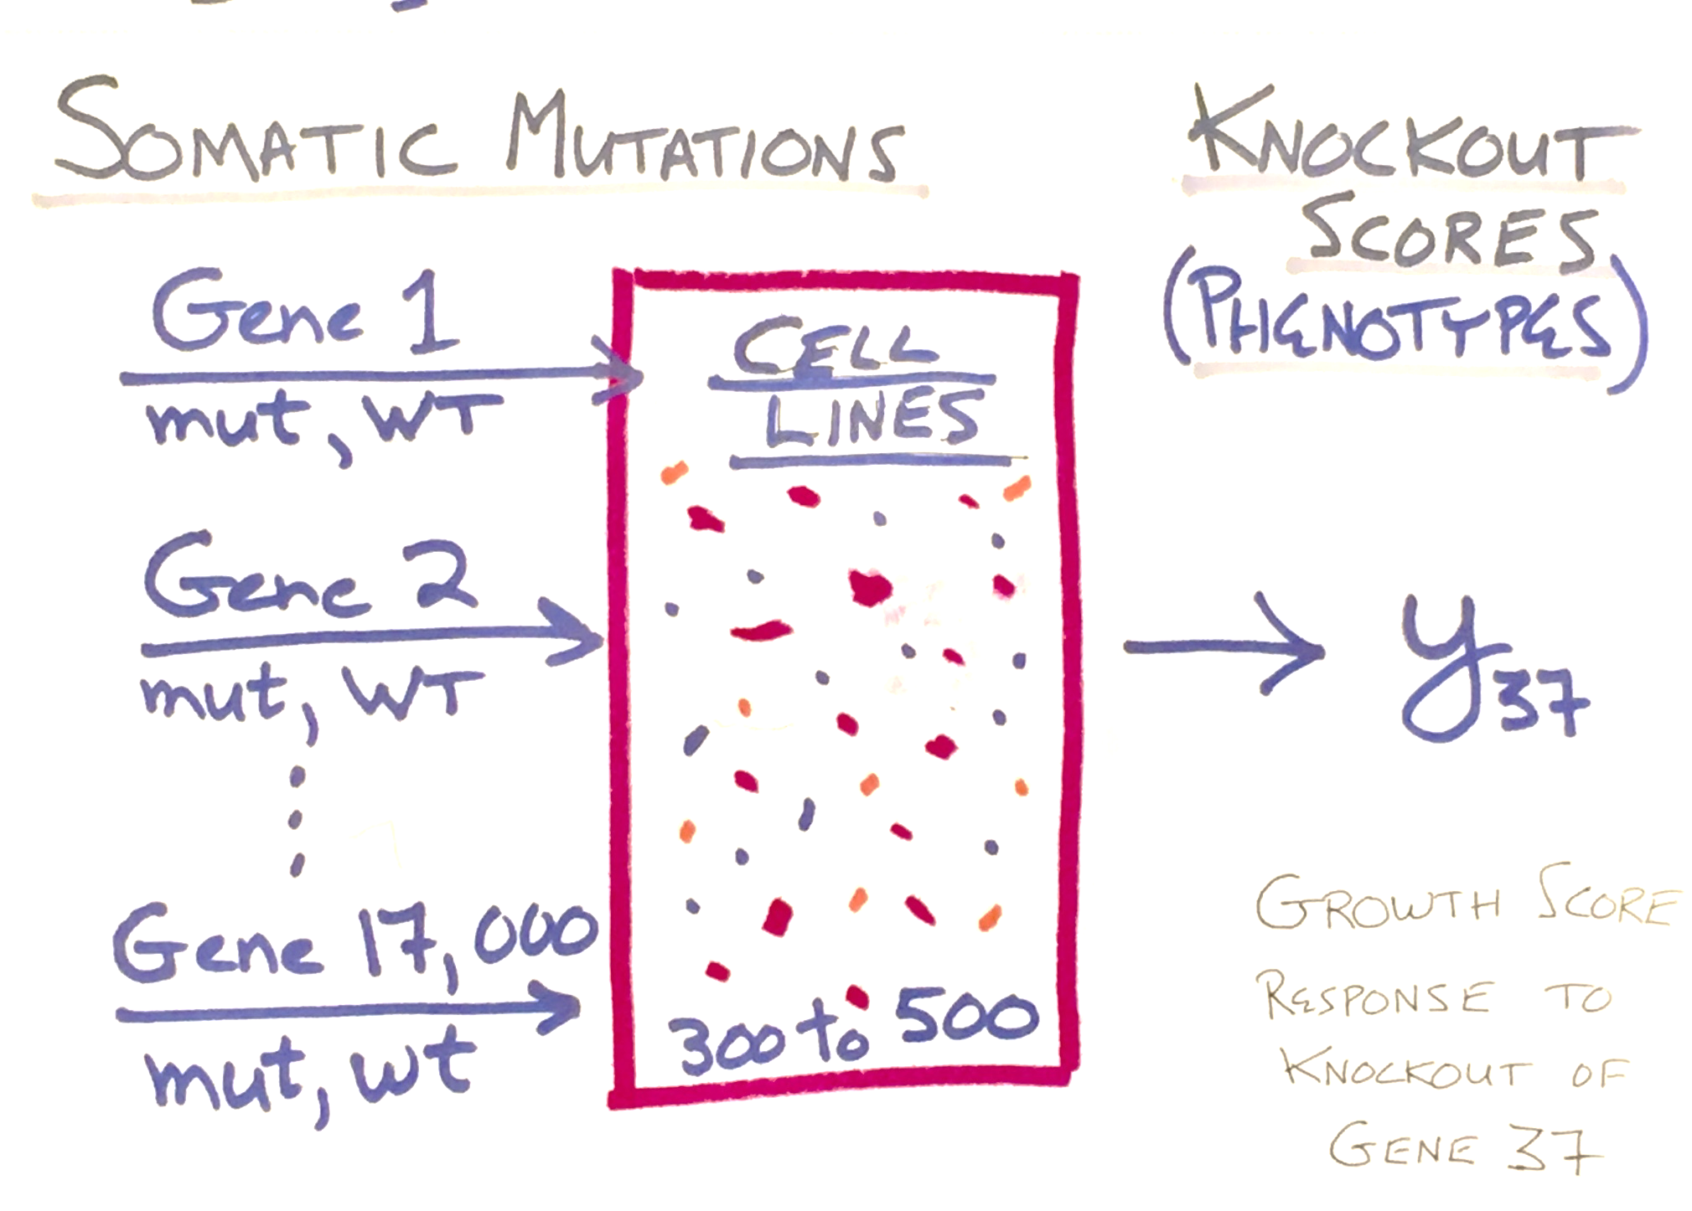

Slide 10
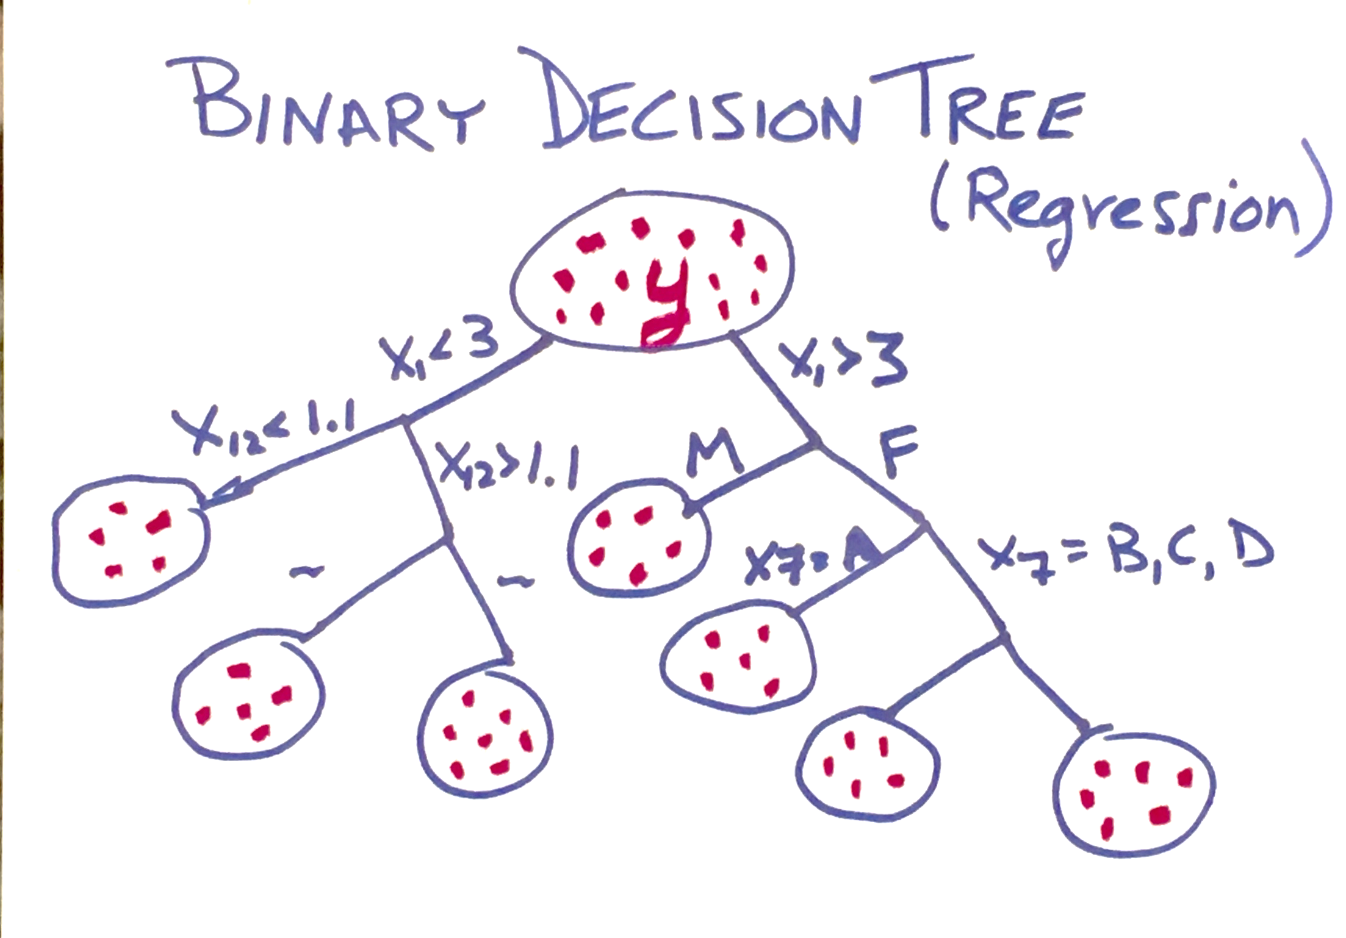

Slide 11
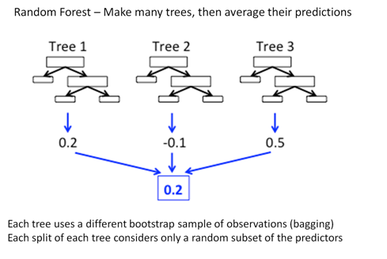

Slide 12
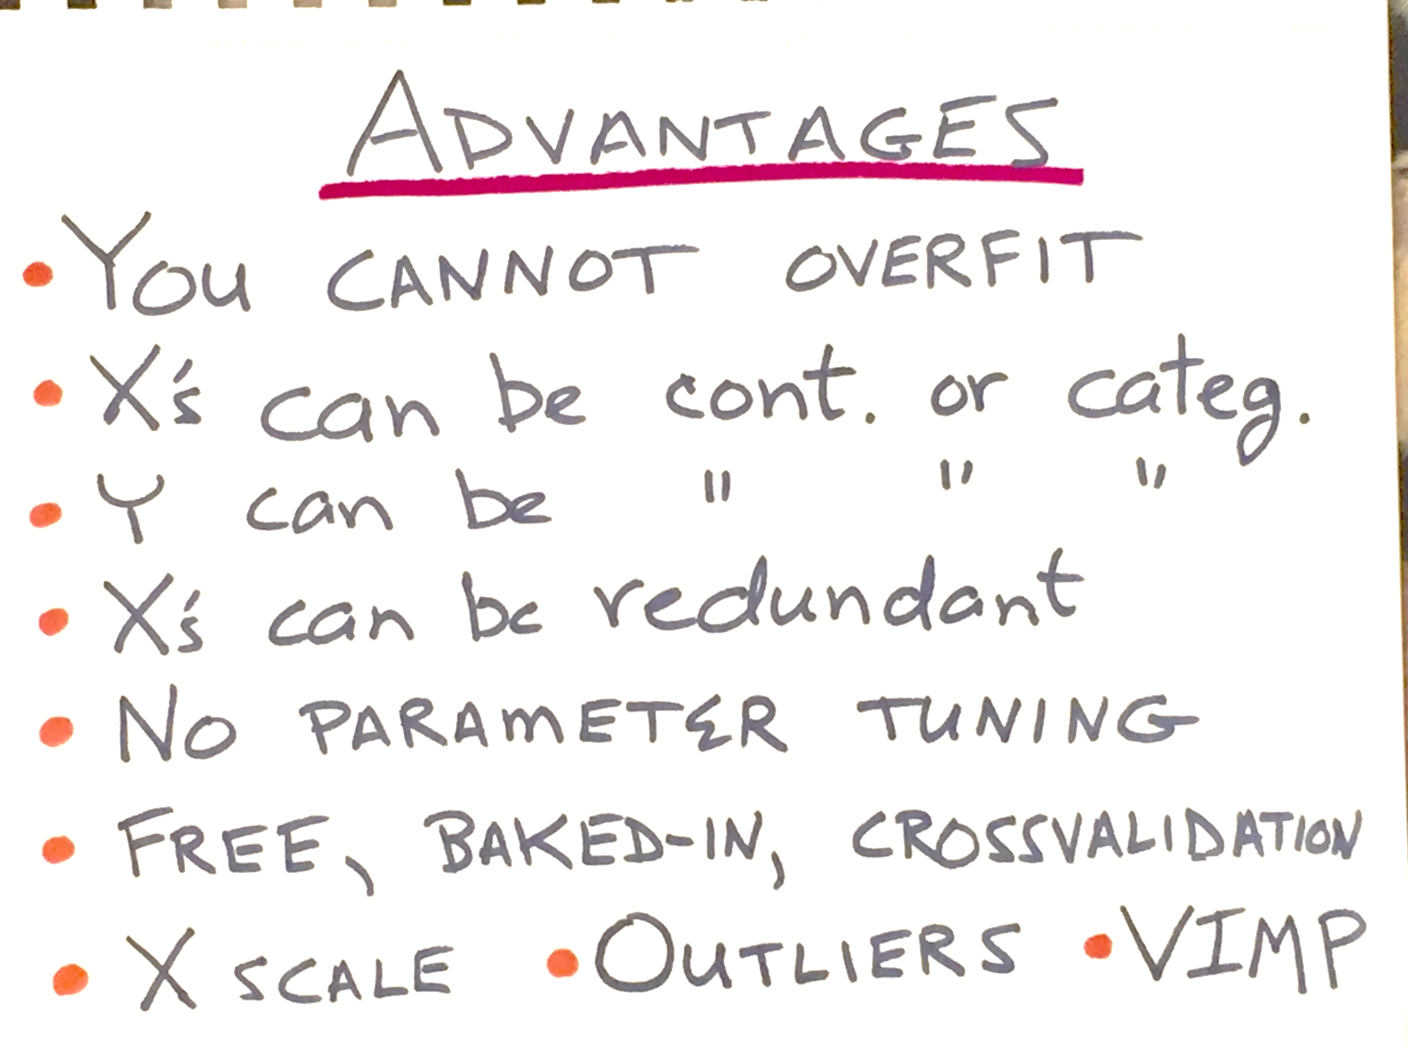

Slide 13
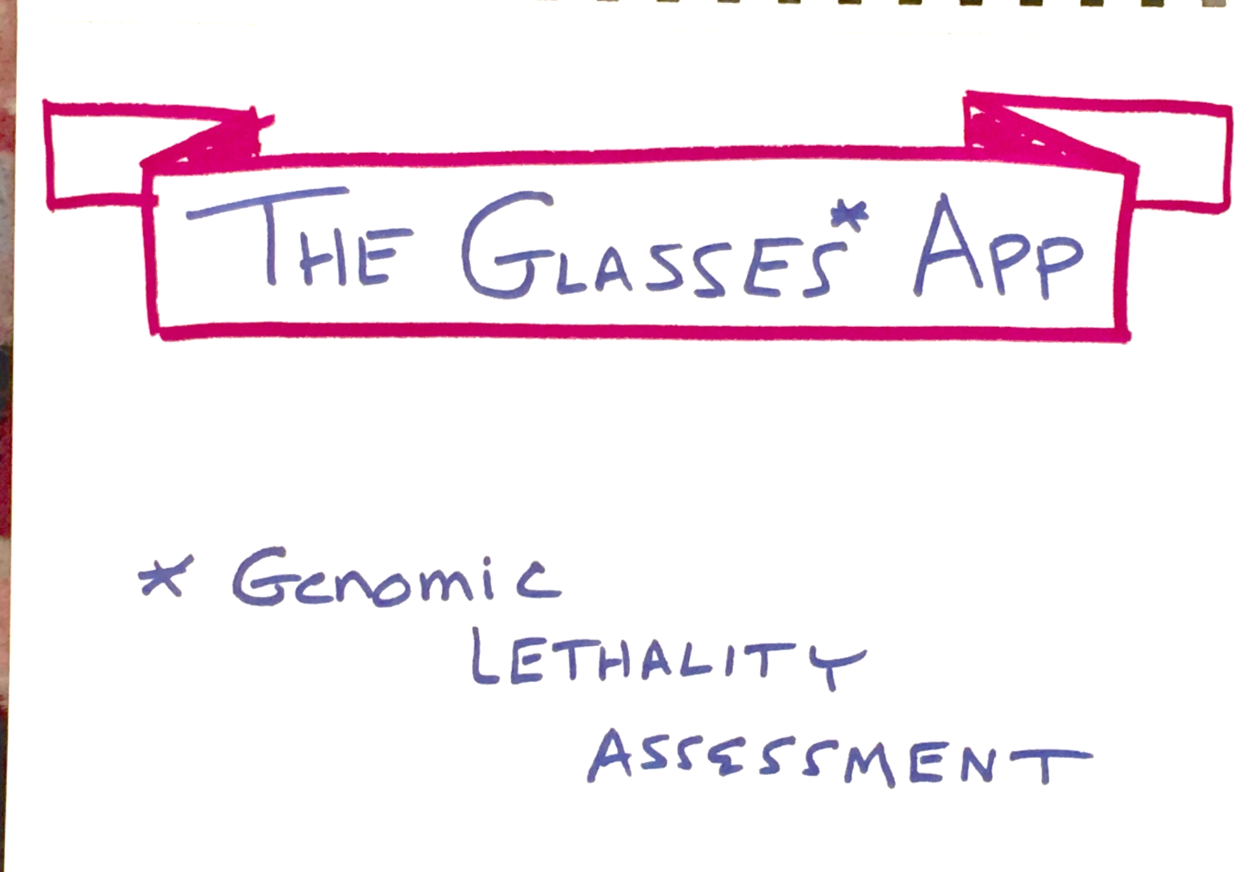

Slide 14
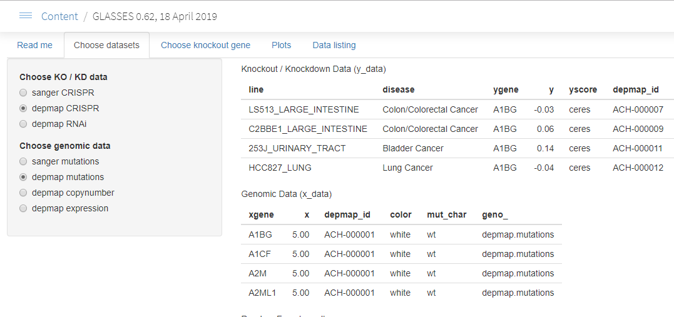

Slide 15
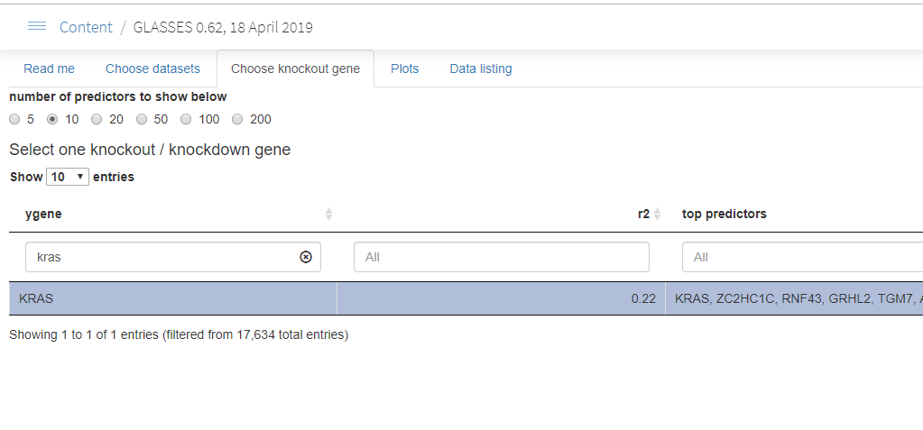

Slide 16
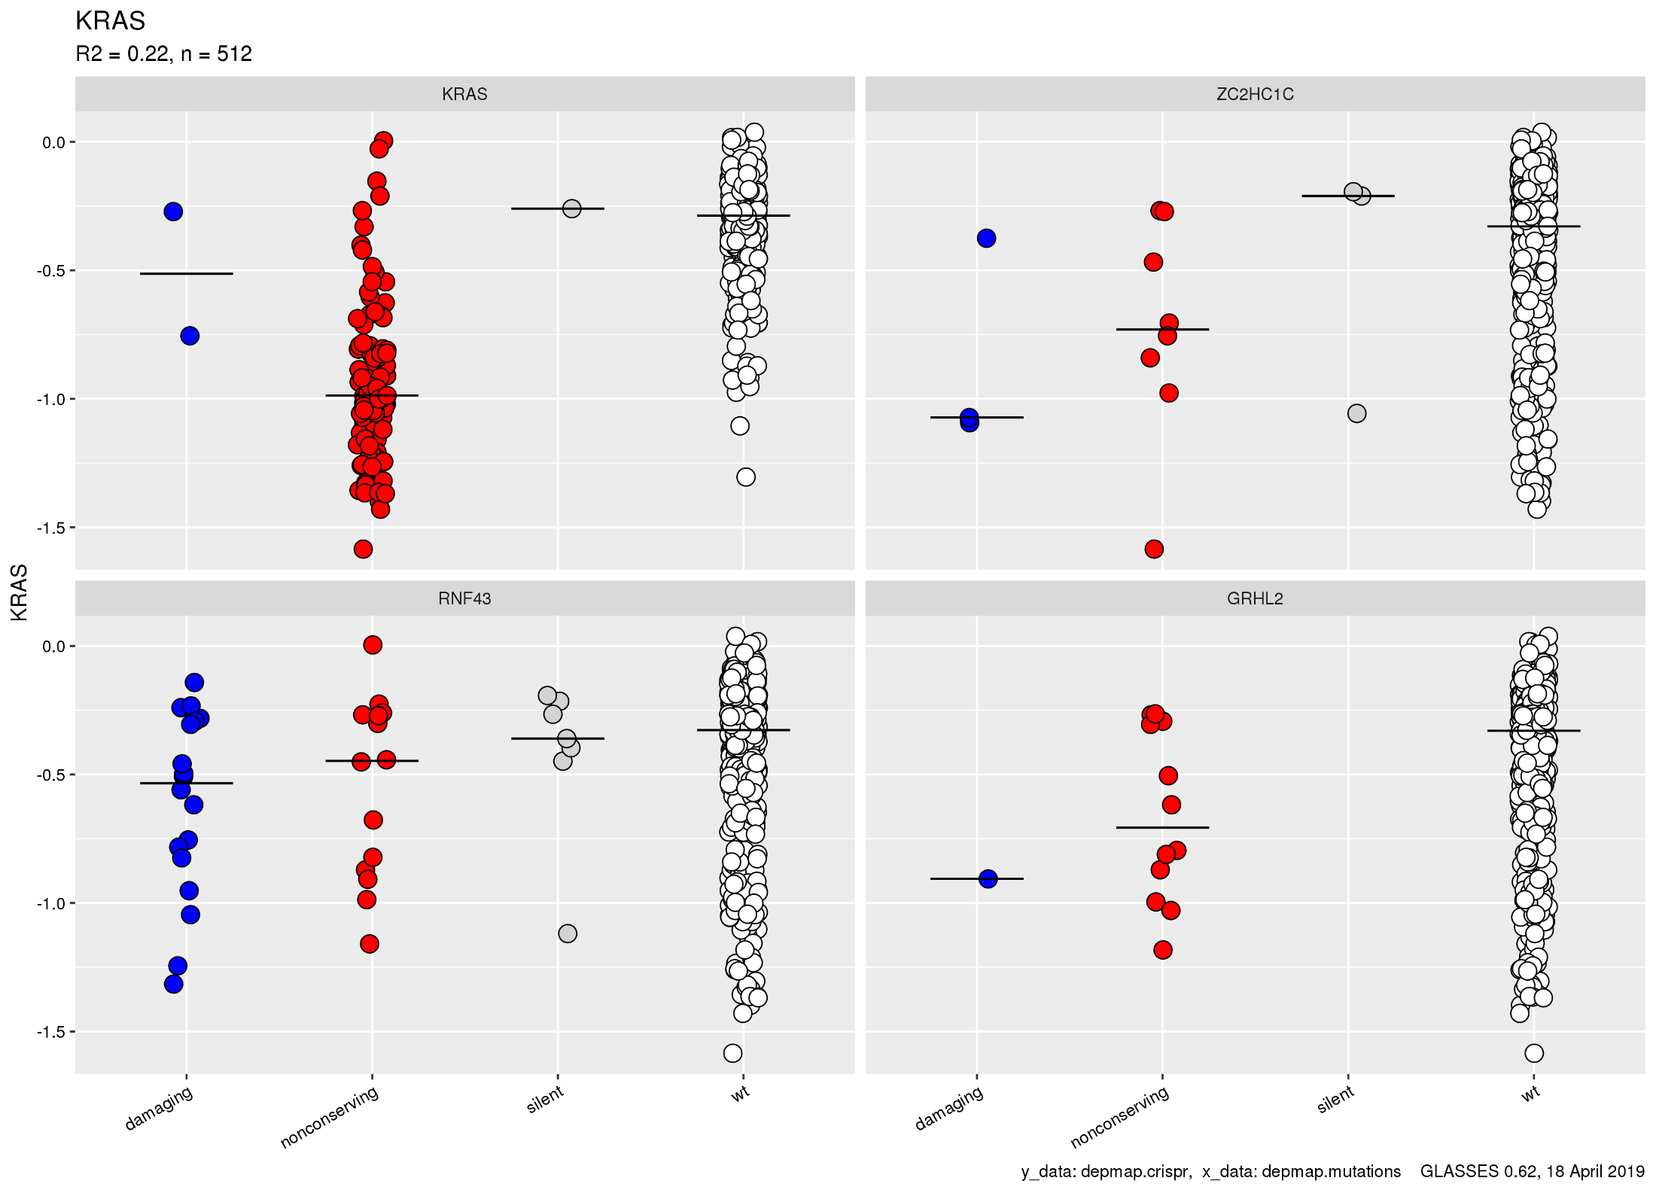

Slide 17
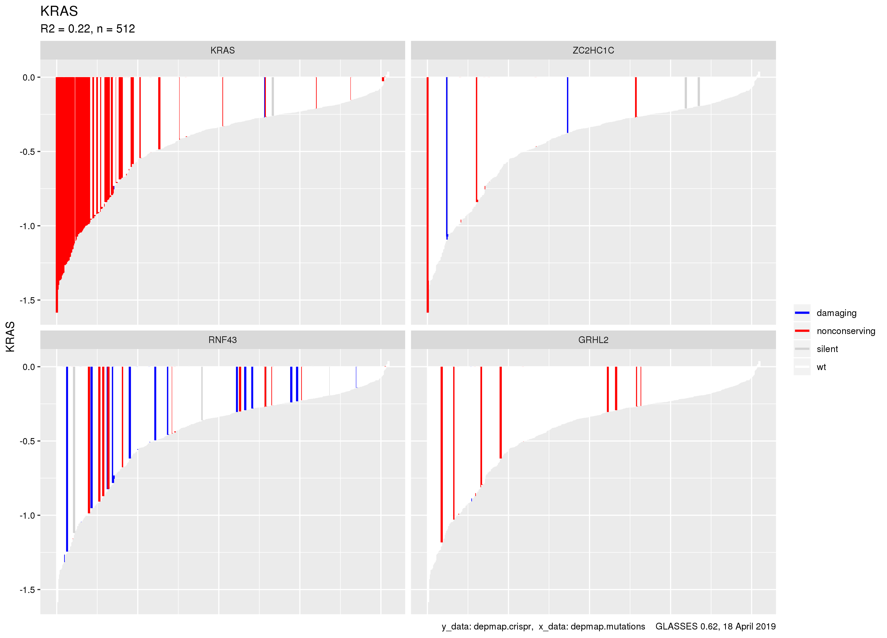

Slide 18
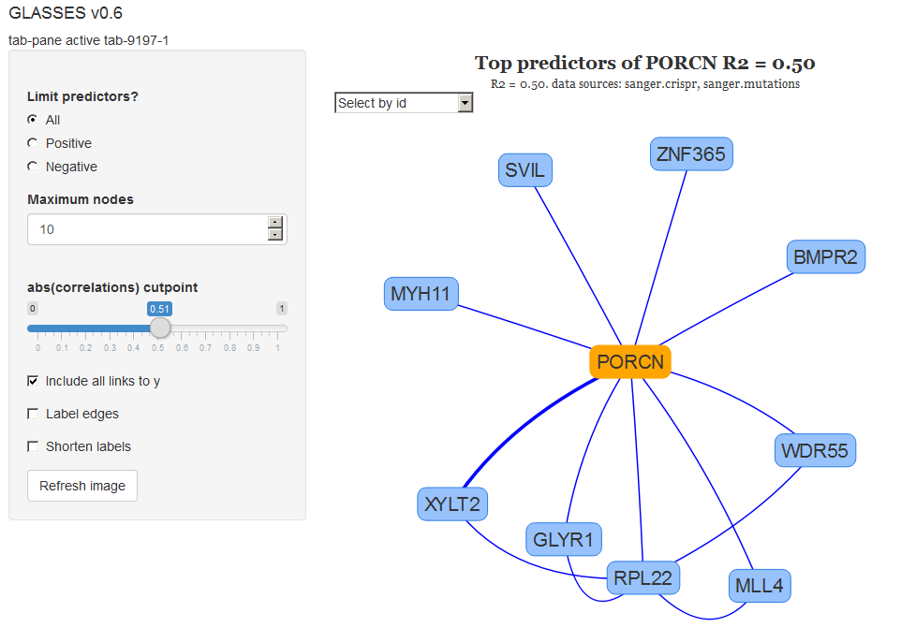

Slide 19
Impacts & Related News
31 targets were vetted for tractability
4 targets were internally validated by CRISPR
GSK Development screened our compound collection for tool compounds against these
GSK bought Tesaro, which has a synthetic lethal compound in clinical development

Slide 20
Next steps for the GLASSES app
Make a new network tool to learn: Are the top predictors overrepresented in any known genetic pathways? (Metacore) Same question, but throw in the knockout gene Gene set enrichment analysis, or a bucket analysis
Create composite knockout scores that combine growth data from our three suppliers
More cell lines will increase power to discover SL pairs
Mixed effect models: random supplier, fixed cell lines

